Slide 1

Misty Tutorial
Raymond Cuijpers Simon Belgers
r.h.cuijpers@tue.nl s.belgers@tue.nl
Technische Universiteit Eindhoven 0HVR00 | 0HM280

Slide 2
Overview
    General introduction to the Misty Robot
    Using Python
NAO and Pepper Tutorial

Slide 3
General introduction to the Misty Robot
Title of Presentation – by Insert Header and Footer text

Slide 4
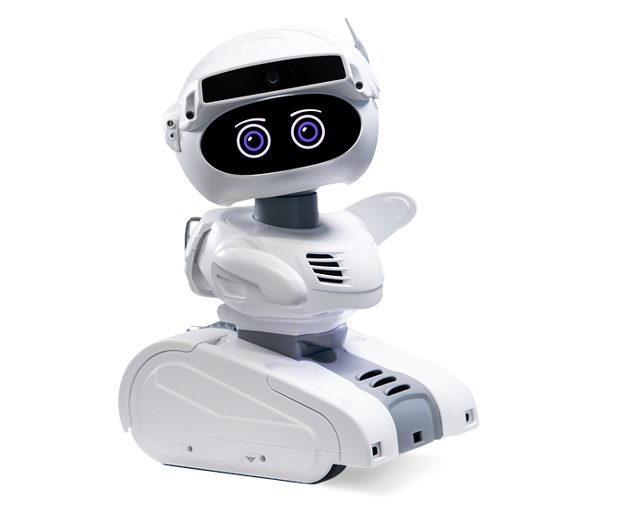
The Misty Robot
    Misty’s expertise:
      Social interactions
      Conversations
      Facial expressions
    Misty’s learning points:
      Advanced gestures
      Larger distance navigation
NAO and Pepper Tutorial

Slide 5
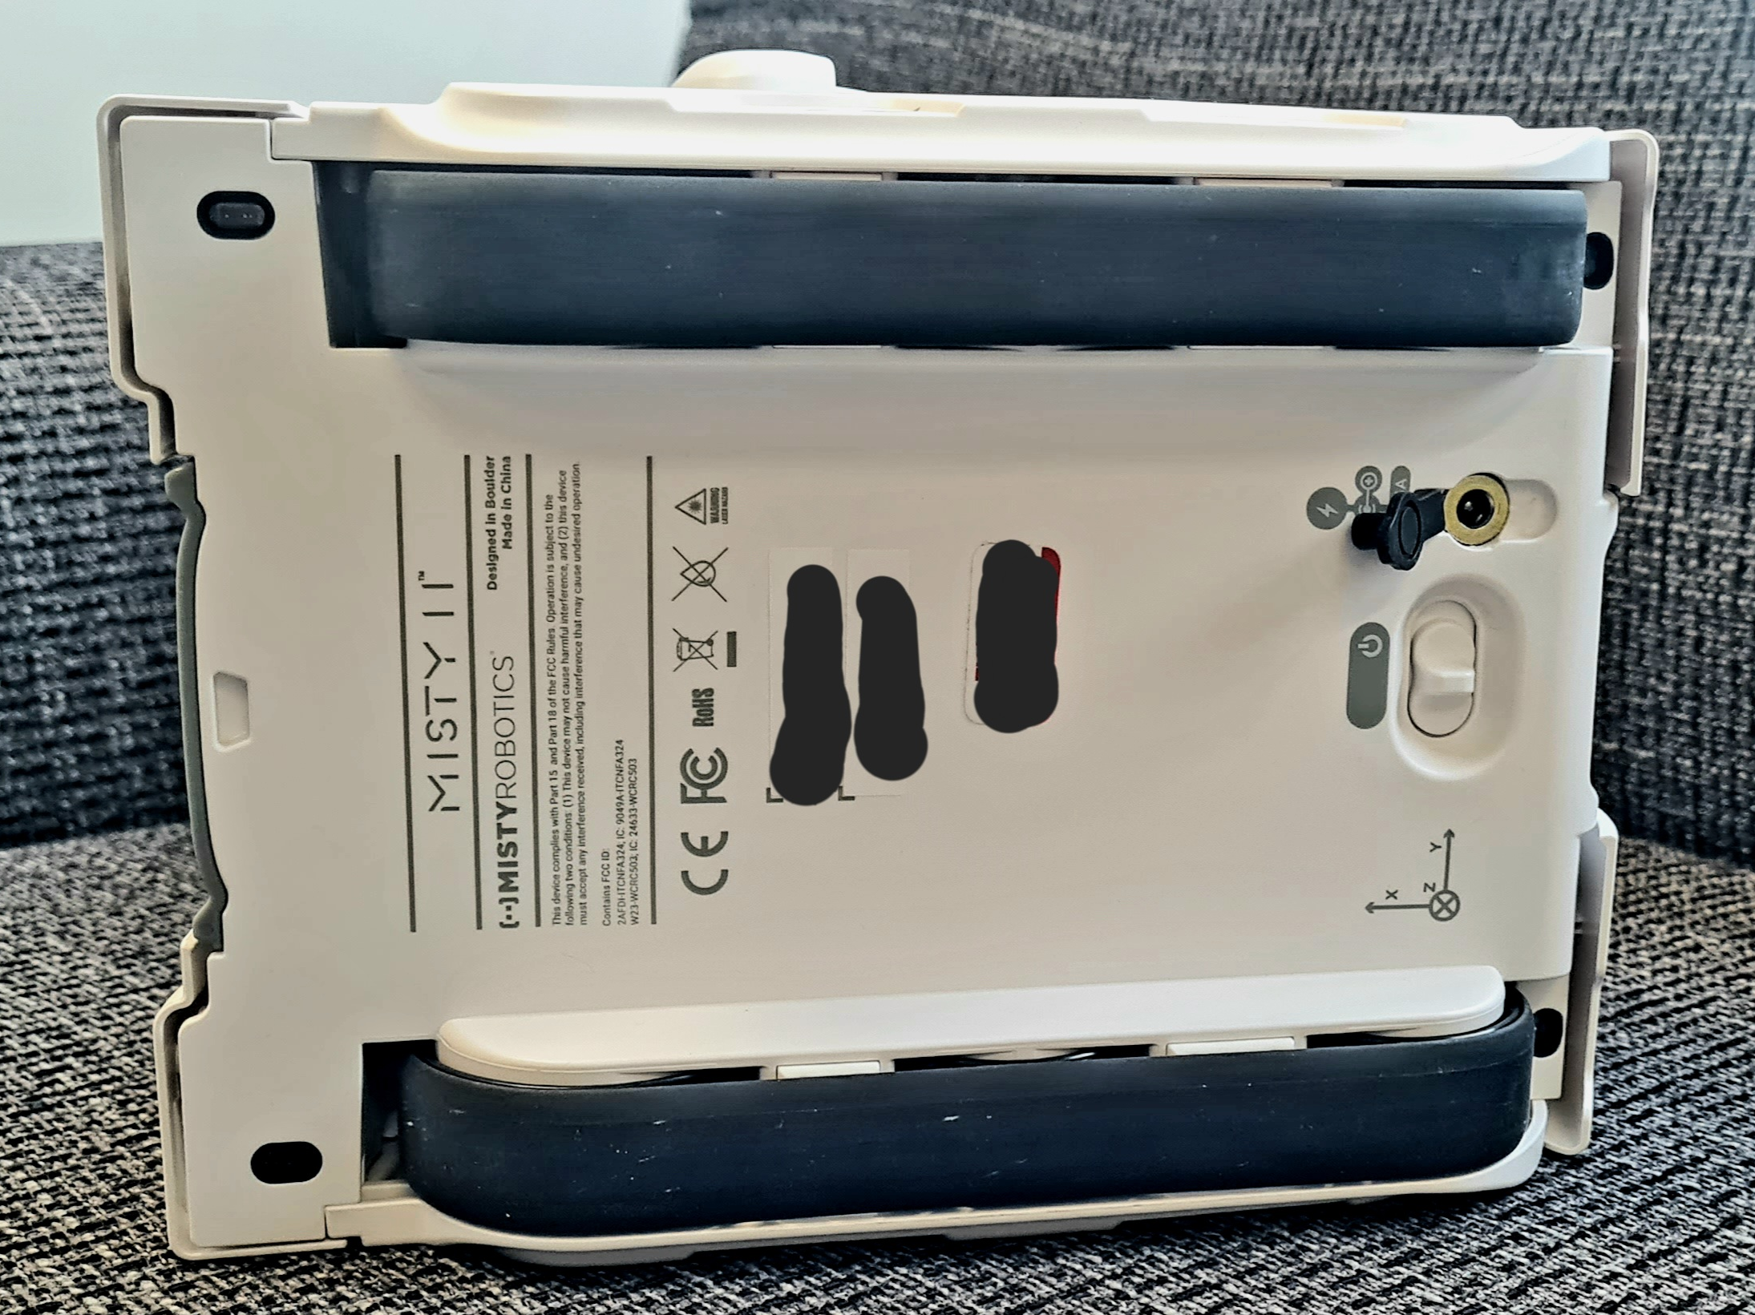
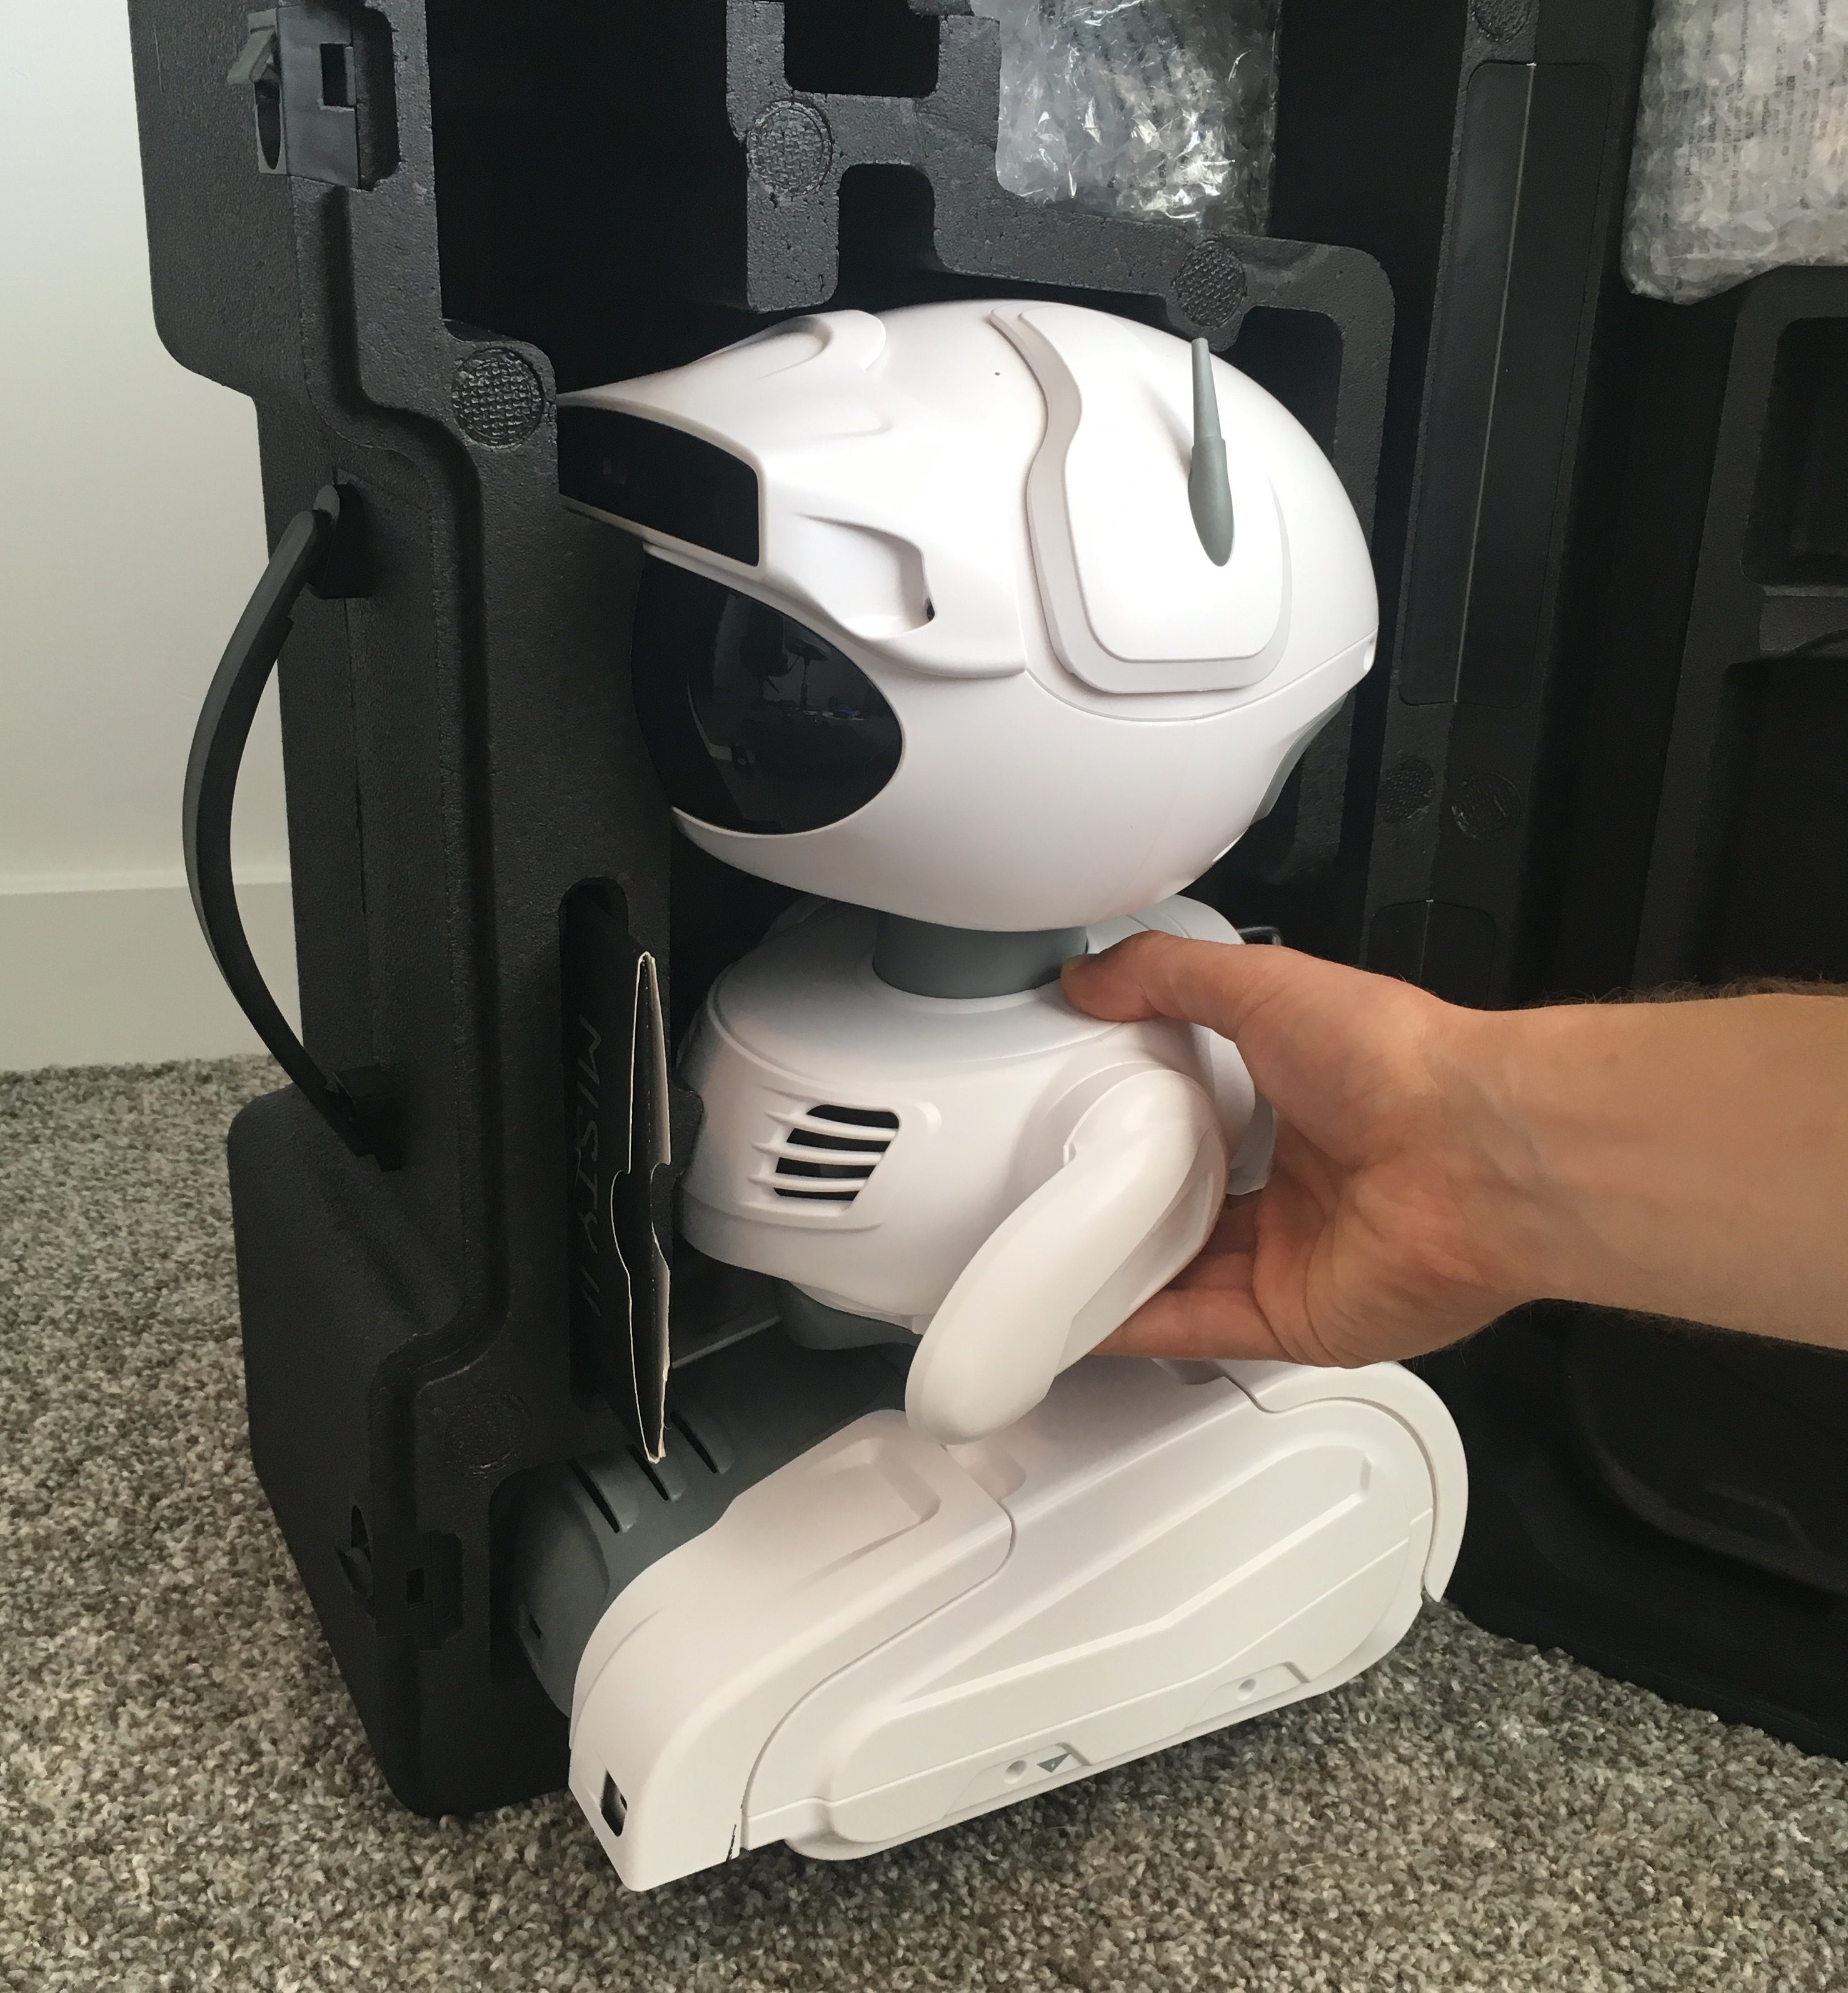
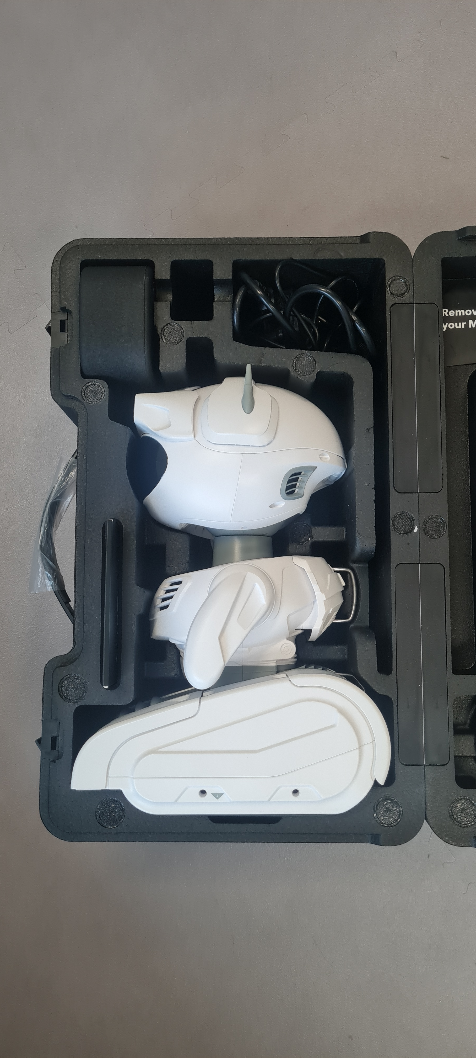
Working with Misty
Charging
    Unboxing
      Put the box on the side so Misty is oriented head-up
      Gently pull Misty out by the body. Do not use force
      Do not pull on the arms or head
      Plug cable in at bottom of Misty to charge
    While testing
      Is someone else working with the Robot?
      Always place the robot on the floor
    Un-unboxing (re-boxing?)
      Ensure the arms are in the correct position
      It only fits in one way
      Do not push the lid
On/off
NAO and Pepper Tutorial

Slide 6
Connecting to Misty
    Set up the router (Generally done by Tutors)
      Plug in the ethernet cord (if ports are available in the building)
        If this is not available, you and Misty won’t have an internet connection.
        Need to look something up on the internet? Temporarily switch back to TU/e network or use another device.
      Plug in the power cord
      Connect: Password and SSID on the bottom of router
    Connect to the web interface
      http://192.168.0.151/ or http://192.168.0.152/ in your browser
      Sometimes it’s a different IP address. This depends on the router.
      Does the video feed show what you expect, and does it update?
Title of Presentation – by Insert Header and Footer text

Slide 7
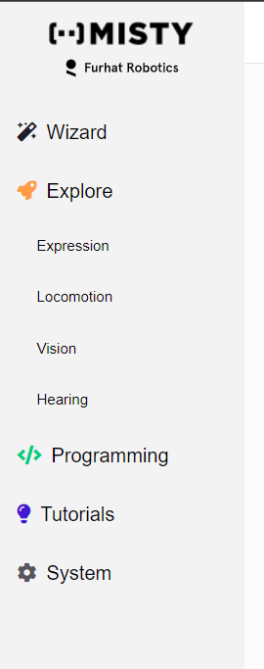
Web Interface
Open the web browser and go to Misty’s ip-address, usually 192.168.0.151
Enter your robot's IP address in the upper-right hand corner of the page and click the Connect button
Wizard – Simple web interface to operate the robot
The other options are not needed.
Title of Presentation – by Insert Header and Footer text

Slide 8
Reserving the robots
    NOT necessary for course 0HVR00 and 0HM280!
    Complete the Robot Tutorial Workshop and we will register your name
    Go to cluster market, login with your student account at https://clustermarket.com
      Choose H&T Labs Reservation System and select the robot from Equipment
      Schedule a time slot
Reserve a lab/room (Atlas building only) for using the robot using cluster market
    Works the same as equipment
Notify the appropriate HTI staff member/Lab support
    Only when it is accepted you an receive the robot(s)
NAO and Pepper Tutorial

Slide 9
Reserving the robots
    NOT necessary for course 0HVR00 and 0HM280!
    Include in your cluster market time slot:
    Names of people who will work with the robot
    Location in Atlas
      preferably the social robotics lab (also needs to be reserved)
      Preferably on the 8th or 9th floor
    Reason of reservation (experiment or testing code or education for <course name>)
    Phone number of one of the students who are using it.
NAO and Pepper Tutorial

Slide 10
Using Python and mistyPy
Title of Presentation – by Insert Header and Footer text

Slide 11
Python and mistyPy Installation (1) – Anaconda
    Screenshots in hidden slides below.
    Install Anaconda Navigator
        https://www.anaconda.com/docs/getting-started/main.
        Pick `Anaconda Distribution for Windows`
        This can take a while, don’t be alarmed if it seems to “hang”
    (Recommended) Create and activate a new virtual environment
      https://www.anaconda.com/docs/tools/anaconda-navigator/tutorials/manage-environments
      Go to “Environments” and click “Create”
      Use python 3.13.11 (latest version gives error in notebook install)
      Activate the environment by double clicking it
    Go to home, and press “Install” on “anaconda_prompt”, “Jupyter notebook”, and “Spyder”
NAO and Pepper Tutorial

Slide 12
Python and mistyPy Installation (1) – MistyPy
    Screenshots in hidden slides below.
    Start “anaconda_prompt”
      install git:
        conda install anaconda::git
        conda install spyder-notebook –c conda-forge
      install mistyPy:
        pip install git+https://github.com/MistyCommunity/Python-SDK.git
        Do not use “pip install mistyPy”, it is outdated
    Start “Spyder” and follow the brief tutorial.
      This is your Python programming environment, also called the Interactive Development Interface (IDE).
      Leave Spyder open for now.
NAO and Pepper Tutorial

Slide 13
Testing if it works (1)
Connect to the router’s WIFI with your laptop
    It may take a few minutes for the router to start up.
    You can only access the internet if the router is plugged in to Atlas’s network.
    Without internet, almost everything still works.
Start the robot
    Button on the bottom
    See “Working with Misty” slide
Connect to the ip address of misty in your browser
    Currently: ask lab support or the tutors for the IP address. We are working on this!
Is your browser seeing through Misty’s camera?
    And is this the correct Misty?

Slide 14
Testing if it works (2)
Start Spyder-notebook and test!
    Open Anaconda Manager
    Select the correct environment in “Environments” and Start “Spyder” in “Home”
    “Undock” the spyder-notebook pane (see image)
    Open the example code
      https://github.com/Rctue/misty-lib/blob/main/basic_example.ipynb
    Pop out the Spyder-Notebook pane and open the basic example notebook
Check if you can use Misty
    Is no one else working with Misty?
    Work through the Spyder-notebook
    Can you make it work in a normal .py file?

Slide 15
More lessons and documentation
Check all available functions:
    https://lessons.mistyrobotics.com/python-elements/misty-python-api
Can you complete the lessons?
    https://lessons.mistyrobotics.com/python/python-lessons/lesson-1-loco-motion
Title of Presentation – by Insert Header and Footer text

Slide 16
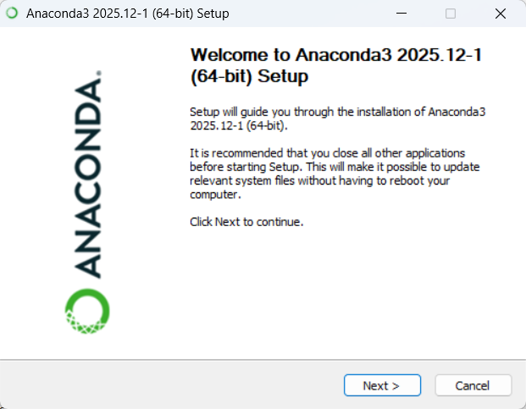
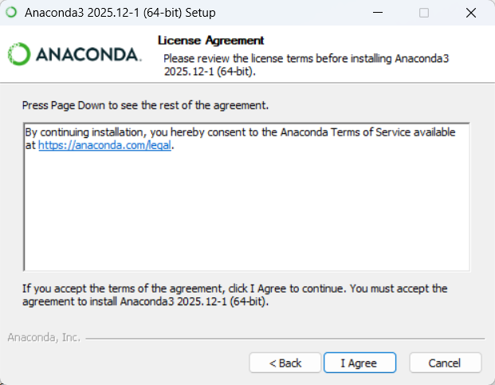
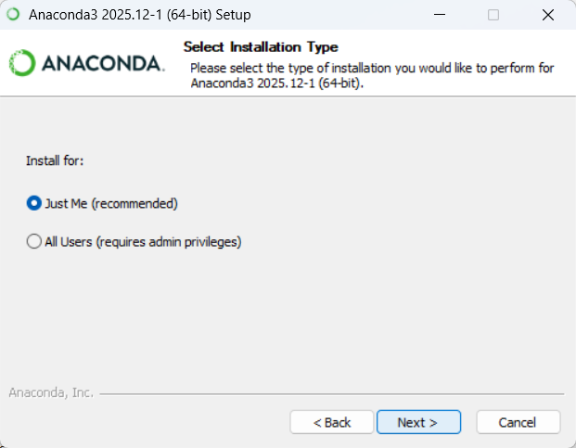
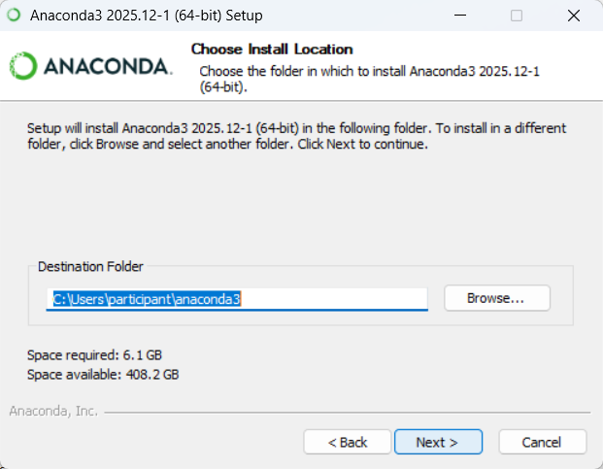
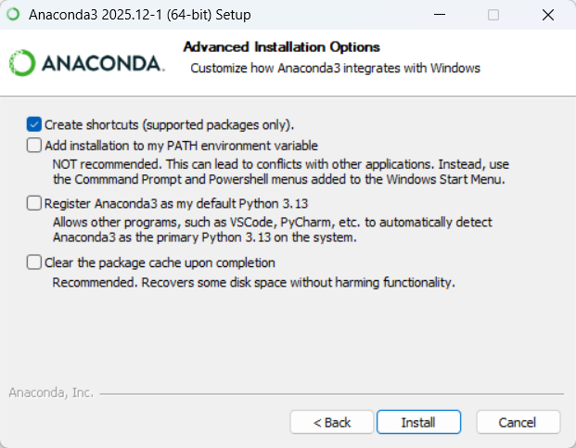
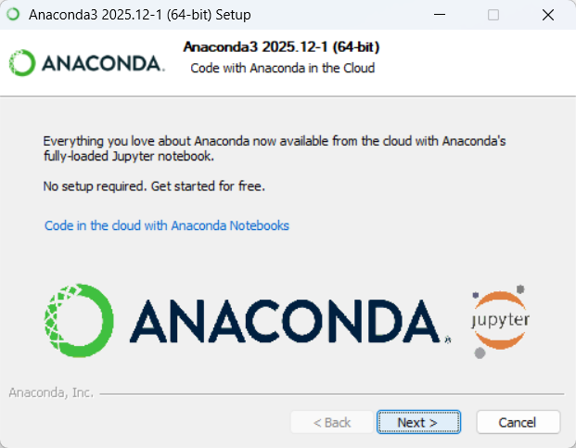
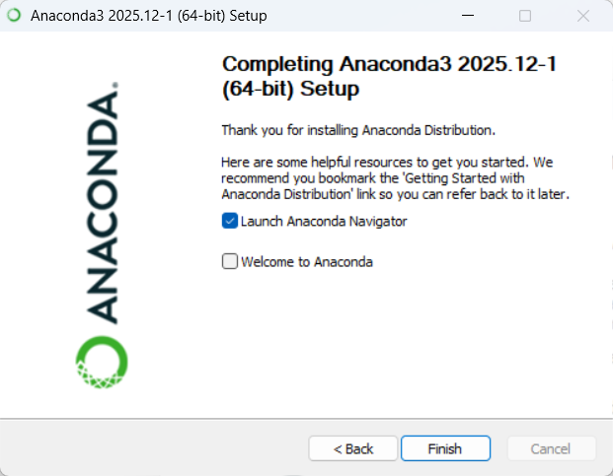
Detailed picture guide (1)
    Install Anaconda Navigator
        https://www.anaconda.com/docs/getting-started/main.
        Pick `Anaconda Distribution for Windows`
        This can take a while, don’t be alarmed if it seems to “hang”
        Default settings are okay

Slide 17
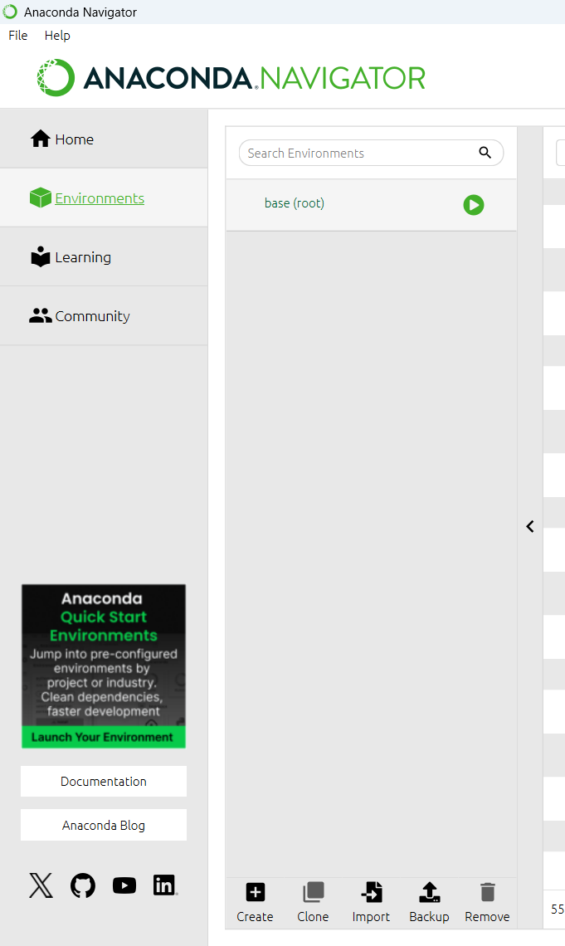
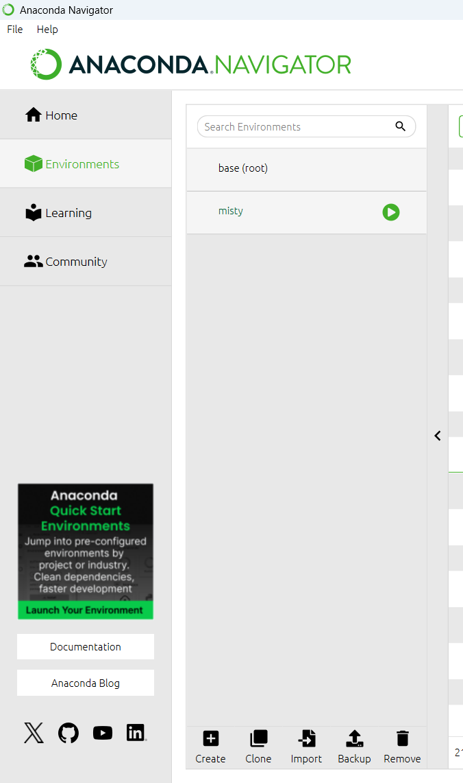
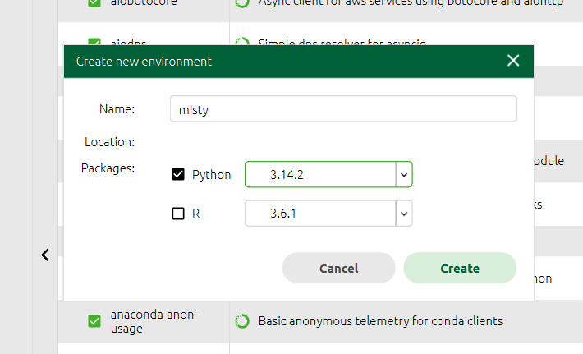
Detailed picture guide (2)
    (Recommended) Create and activate a new virtual environment
      https://www.anaconda.com/docs/tools/anaconda-navigator/tutorials/manage-environments
      Go to “Environments” and click “Create”
      Use python 3.13.11 (latest version gives error in notebook install)
      Activate the environment by double clicking it
3.13

Slide 18
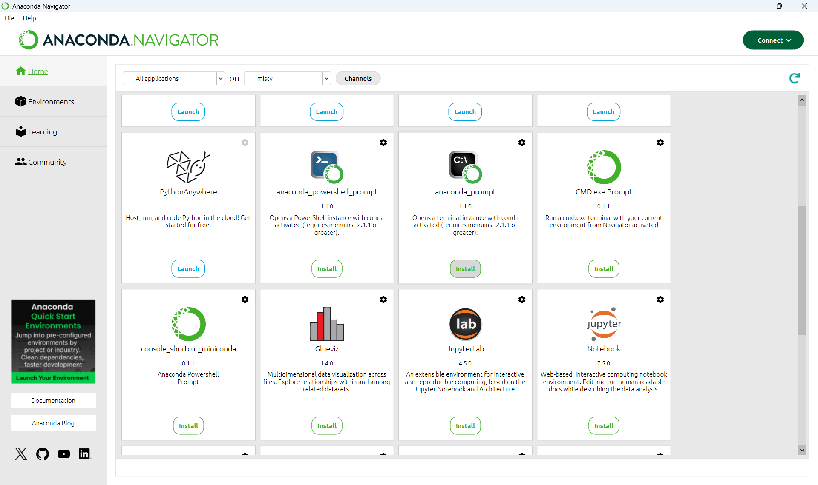
Detailed picture guide (3)
    Go to home, and press “Install” on “anaconda_prompt”, “Jupyter notebook”, and “Spyder” (Spyder not in picture, but similar process)

Slide 19
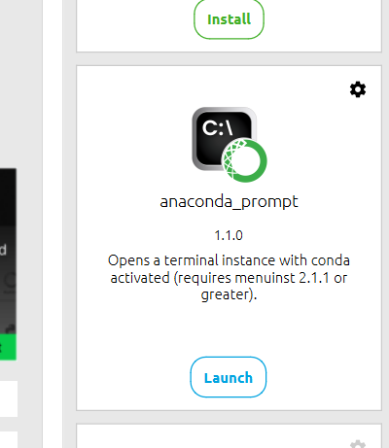
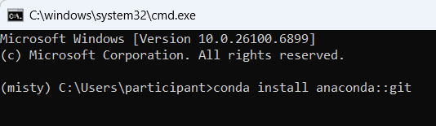
Detailed picture guide (4)
    Start “anaconda_prompt”
      install git by typing the following command:
        conda install anaconda::git
        conda install spyder-notebook –c conda-forge
      install mistyPy:
        pip install git+https://github.com/MistyCommunity/Python-SDK.git
        Do not use “pip install mistyPy”, it is outdated

Slide 20
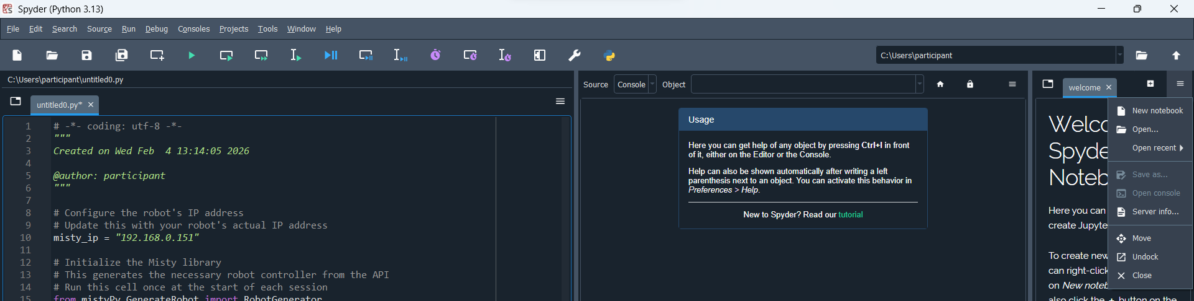
Detailed picture guide (6)
Start Spyder-notebook and test!
    Open Anaconda Manager
    Select the correct environment in “Environments” and Start “Spyder” in “Home”
    “Undock” the spyder-notebook pane (see image)
    Open the example code
      https://github.com/Rctue/misty-lib/blob/main/basic_example.ipynb
    Pop out the Spyder-Notebook pane and open the basic example notebook

Slide 21
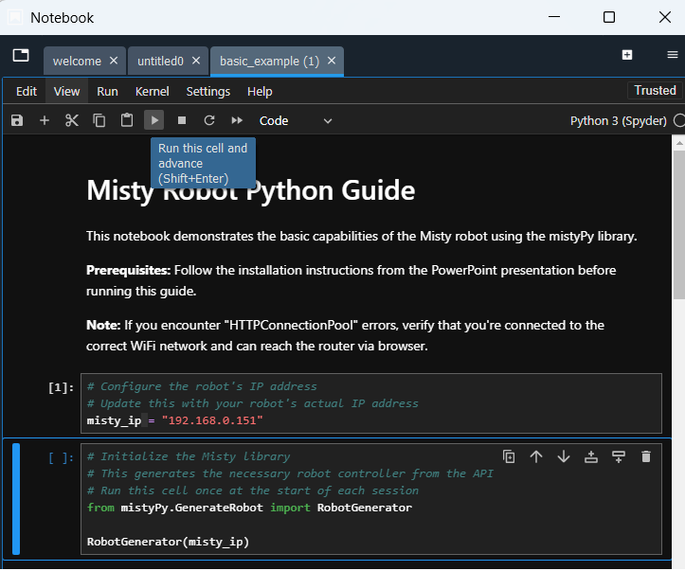
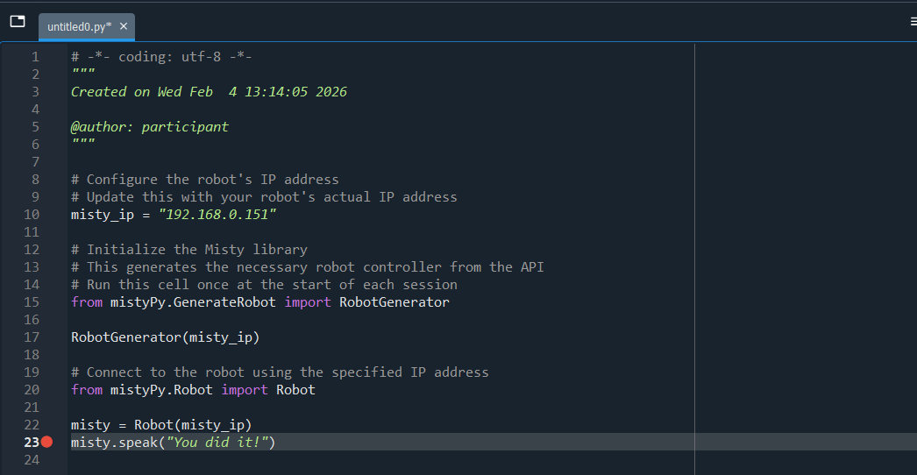
Detailed picture guide (6)
Check if you can use Misty
    Is no one else working with Misty?
    Work through the Spyder-notebook
    Can you make it work in a normal .py file?

